Slide 1

Data Pipeline and Quality Management week 3
Sai krishna reddy m

Slide 2
Pipeline Overview extraction raw data from the relational database. Transformations like removing duplicates, handling missing values, outlier detection and removing them applied on the data set. Storing clean data in a new schema.
Notes:
First data is extracted from relational data base and applied transformation techniques likes removing duplicates, handling missing values and outlier detection and removing them.

Slide 3
Pipeline Selection Selected Batch pipeline Process. The dataset is static and does not require real-time processing. And batch processing allows transformation, cleaning, and feature engineering. It ensures consistency and quality checks before ingestion into storage. Data Storage Format Selection The selected data storage format is Parquet. Parquet is a columnar storage format optimized for analytical queries. It provides better compression, reducing storage space requirements. Suitable for large-scale machine learning tasks and distributed processing.
Notes:
In this slide we can see first selected pipeline as batch pipeline type for this project because our dataset is not continuously updating. The batch approach allows us to perform data extraction, transformation. This is particularly useful when dealing with structured datasets, where we need to perform feature engineering, handle missing values, and ensure data quality before storage.
For storing the processed data I have selected Parquet as the preferred format. Parquet is a columnar storage format that is highly efficient for analytical queries, making it well-suited for machine learning and data analysis tasks.

Slide 4
Pipeline Diagram PostgreSQL (raw.iris_data) │ ▼ Data Cleaning Steps - Missing Values Check - Duplicate Removal - Outlier Handling │ ▼ Feature Engineering │ ▼ PostgreSQL (cleaned.iris_data) │ ▼ Postgre
Notes:
This diagram gives the clear idea of batch data pipeline. I first retrieve data from the database, cleaning, checking missing values, duplicates removal, outlier detection, feature engineering and store it back in a structured format.

Slide 5
Data Quality Issues Missing Values : Find or checking for missing values if any found solving them Duplicates : Detected and removed duplicate values with drop_duplicates() Outliers: outliers are identified and removed using method IQR method Categorical variable : converting categorical variable to numerical variable Feature Engineering : Found new feature with the help of feature engineering Feature scaling : Feature scaling is the process of normalizing or standardizing numerical features
Notes:
Data quality issues were used for checking for missing values, duplicate entries, and outliers. While no missing values were found initially but after feature engineering I found missing values and cleared it, duplicates were removed, and outliers were handled using statistical technique like IQR method.

Slide 6
Data Validation And Checking Missing Values Check : Checking missing values if any with isnull().sum(). Duplicates Detection: Detected duplicates if any with duplicated().sum().
Notes:
To ensure high data quality, I implemented validation checks. We used statistical method like IQR method to detect outliers and confirmed data consistency using visualization techniques.

Slide 7
A Plan To Detect Data Drift Or Schema Change Over Time Regular monitoring of statistical distributions with change in time. Checking regularly for significant deviations. Checking for incoming data that matches the existing data format and type before it is getting processed.
Notes:
With changing time, data distributions may change due to different sources or real-world shifts. Monitoring statistical properties ensures that the model receives consistent inputs means the received data is in same format as existing data format. Schema validation helps detect unexpected changes in data format.

Slide 8
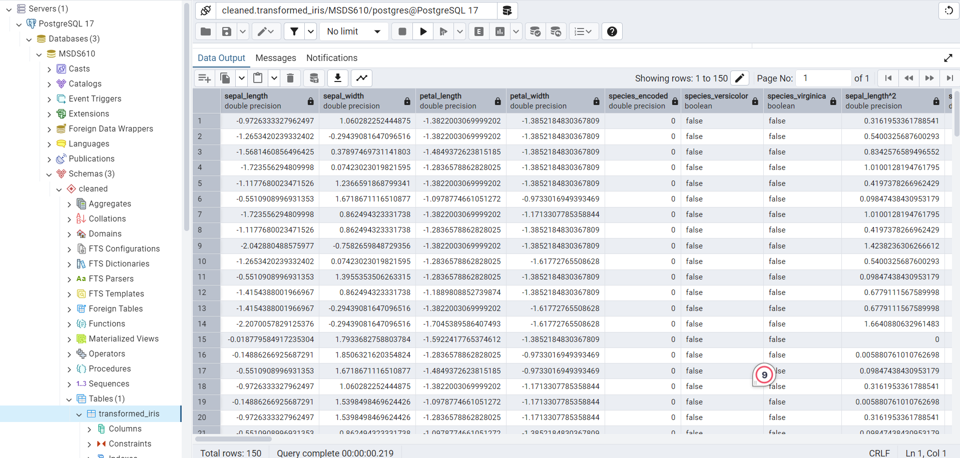
Screenshot Of Loaded Data
Notes:
This is the screen shot storing the data in cleaned schema.

